Slide 1
User Defined Functions

Slide 2
Introduction
Large programs is broken down into smaller units known as functions.
A function is a sub program that acts on the data passed into the function and often returns a value.
Function helps reduce the program size and avoid ambiguity.

Slide 3
Types of Functions
Built in functions
User defined functions

Slide 4
Built in functions
These functions are part of the compiler package, these are part of the library made available by the compiler.
Eg exit(), pow(),sqrt()

Slide 5
User-defined functions
These are created by you i.e, the programmer, as per requirement of your program.

Slide 6
All function must have the following:
Function prototype / function declaration
Function definition
Function call

Slide 7
Function Prototype
A function prototype is a declaration of the function that tells the program about the type of the value returned by the function and the number and type of parameter passed.
Eg: int sum() ;
int sum(int , int );

Slide 8
General form of function prototype is:
Type function-name ( parameter list)
Eg float volume( int , float );
return type – float ( a float value will be returned)
function name- volume
parameter – 2 ( one int and one float)

Slide 9
All Functions has 3 part
Return type
Function name
Parameter
Eg void sum ( )
return type – void - no return type
function name- sum
parameter - Nil

Slide 10
Function call
How will you call the function created by you in the program?
It can be done using function call
Eg assume prototype as
void sum (int ,int );
Function call: sum(7,8); // sum(a,b);

Slide 11
void main()
{ void sum(int, int);
int a,b;
cin>>a>>b;
sum(a,b);
getch(); }
void sum(int a, int b)
{ cout<<a+b;}

Slide 12
Write the function prototype and function call for the following
Return type is void ,function name add, 1 float parameter.
Ans: void add(float );
Call: add(a); //assume a is declared

Slide 13
Write the function prototype and function call for the following
Return type is float ,function name even, 2 float parameter.
Prototype: float even(float,float);
Call: float sum=even(a,b);
//assume a,b is already declared.

Slide 14
Write the function prototype and function call for the following
Return type is int ,function name sum, 2 float parameter and one int
Prototype: int sum(float,float,int);
Call: int a=sum(c,d,e);

Slide 15
Function definition
void sum()
{ int a,b,sum;
cin>>a>>b;
sum=a+b;
cout<<sum;
}
int sum()
{ int a,b,sum;
cin>>a>>b;
sum=a+b;
cout<<sum;
return sum;
}

Slide 16
Function definition
int sum(int a,int b)
{ int sum=a+b;
cout<<sum;
return sum;
}
void sum(int a,int b)
{ int a,b,sum;
cin>>a>>b;
sum=a+b;
cout<<sum;
}
int

Slide 17
Function prototype & function definition
Function prototype
float volume(float ) ; // prototype ends with semi colons
Function call:
Float ans=volume(4.5);
Function definition
float volume (float a)
{ float n;
n =a*a*a;
return n; }

Slide 18
Program to print cube of a given number using function
void main()
{ float a;
void cube(float a);
cin>>a;
cube(a);
cout<<“ Job Done:”;
}
void cube(float b)
{ float c
c=b*b*b;
cout<<“cube”<<c;
}

Slide 19
Note a function prototype is not needed if the definition of the function is given before the function call ( ie before void main).

Slide 20
Program to print cube of a given number using function
void cube(float b)
{ float c
c=b*b*b;
cout<<“cube”<<c;
}
void main()
{ float a;
void cube(float a);
cin>>a;
cube(a);
cout<<“ Job Done:”;
}

Slide 21
Multiplication of 2 numbers
// without parameter and no return type
FP : void multiply();
FC : multiply();
FD : void multiply()
{ int a,b,p=0;
cout<<“ENTER THE NUMBER :”; cin>> a>>b;
p=a*b;
cout<<“\n The product is :”<<p;
}

Slide 22
// with parameter & without return type
FP – void multiply(int,int);
FC: multiply(a,b);
FD : void multiply(int a,int b)
{
int p=a*b;
cout<<“ Product =“<<p;
}

Slide 23
// without parameter & with return type
FP – int multiply();
FC: int p = multiply();
FD : int multiply()
{ int a,b;
cin>>a>>b;
int p=a*b;
return(p); // or return(a*b);
}

Slide 24
// with parameter & with return type
FP – int multiply(int,int);
FC: int p=multiply(a,b);
FD : int multiply(int a,int b)
{
int p=a*b;
return p;
}

Slide 25
1 . W.A.P Using function called sumEven to return the sum of even numbers and accept the limit as the parameter.

Slide 26
void main()
{ int n,se=0;
int sumEven(int); //Prototype
cin>>n;
se=sumEven(n); //Function call
cout<<“sum of even=“<<se;
}

Slide 27
float sumEven(int a);
{ int c=0,sum=0;
while(c<=a)
{ if(c%2==0)
sum+=c;
c++;
}
return (sum);
}

Slide 28
QUESTIONS
W.A.P using functions ( with parameter & return type) to calculate the area of a circle.
W.A.P using functions ( with parameter & no return type) for converting cm to feet & inches [ 1 ft=12 inches, 1 inch=2.54cm]
W.A.P to accept 2 nos M,n return the value M^{n} (using with only one parameter and return type)
W.A.P to accept X from a user & return square of X.

Slide 29
5. W.A.P using function to find the average of 3 given numbers.
6. W.A.P using function to accept a number from the user and find the factorial of a number.
7. W.A.P using function to accept a number from the user and returns 1 if the number is positive else 0 if the number is negative.
8. W.A.P using function to accept a number from the user and print the stars in the ascending order.

Slide 30
9. W.A.P using function to accept a number N from the user and find the Fibannaci series till the term N.
10. W.A.P using function to accept a string from the user and pass each character into the function and count the number of digits in the string.
11. W.A.P using function to enter the mark of a student return the grade back.
(100-90 ‘A’,
75-90 ‘B’,
50-75 ‘C’,
ELSE ‘D’ )

Slide 31
FORMAL &ACTUAL PARAMETER
Actual parameter is a parameter that is used in function call statement to send the value to the function.
Formal parameter is a parameter which is used in the function header of the called function to receive the value from the actual parameter.

Slide 32
void main()
{ void multiply(int);
int a;
cin>>a;
multiply(a);
// a is a actual parameter sent to //multiply function
}
void multiply( int c)
{ cout<<c*c; }
// c is the formal parameter

Slide 33
Consider the following code and find the output
void main()
{ for(int i=0;i<3;i++)
{ for(int j=0;j<3;j++);
}
cout<<“i=“<<i<<“j=“<<j;
}

Slide 34
Consider the following code and find the output
void main()
{ for(int i=0;i<3;i++) // var i has scope or life only inside main program
for(int j=0;j<3;j++); // var j is a local variable for that // particular compound stmt or block
{…………………….}
cout<<“i=“<<i<<“j=“<<j; //Will give you an error
}

Slide 35
Will the following code execute ? Justify your answer
void main()
{ int a,x=9;
cin>>a;
void multiply(a);
}
void multiply(int c)
{ cout<<c*x; }

Slide 36
Will the following code execute ? Justify your answer
void multiply(int x)
{ int c=20;
cout<<c*x; }
void main()
{ int a,x=9;
cin>>a;
multiply(a);
}

Slide 37
Variable scope
A variable scope : The program part(s) in which a particular piece of code or a variable can be accessed is known as variable scope.

Slide 38
There are 4 kinds of scopes in c++
Local scope : A variable declared in a block is local to that block and can be used only in it and other blocks contained under it.
void main()
{ int a;
cin>>a;
while(a!=0)
{ int c;
cin>>a; //c has local scope only inside while
c=a;} // a has a local scope even inside file
cout<<c; } //gives you error as scope of c is only inside while block

Slide 39
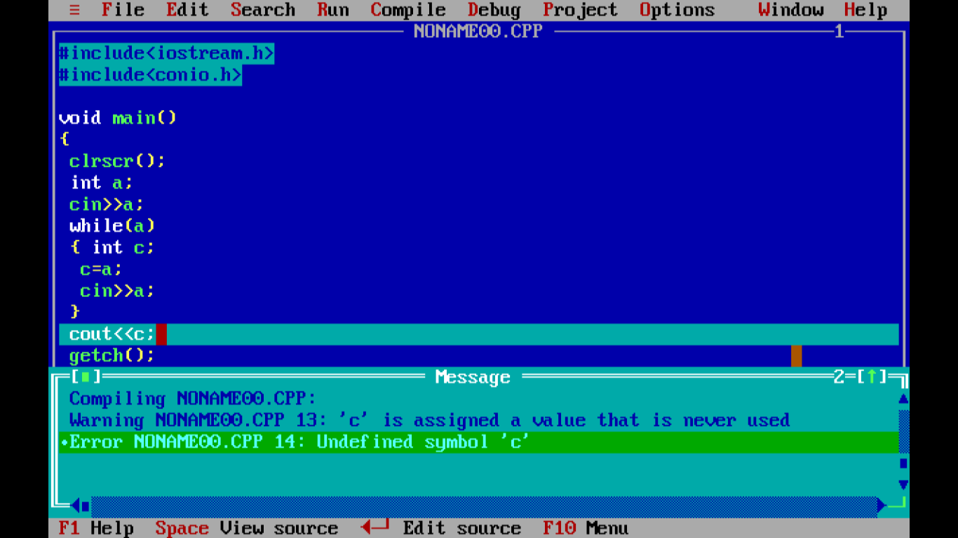

Slide 40
2. Function scope : The variables declared in the outermost block of a function have function scope i.e they can be accesssed only in the function that declares them. ( Label in goto also have function scope).
void sum(int c ,int d)
{ add=c+d;
cout<<add;
}
void main()
{ int add;
void sum(int ,int);
int a=3,b=5;
sum(a,b);
}

Slide 41
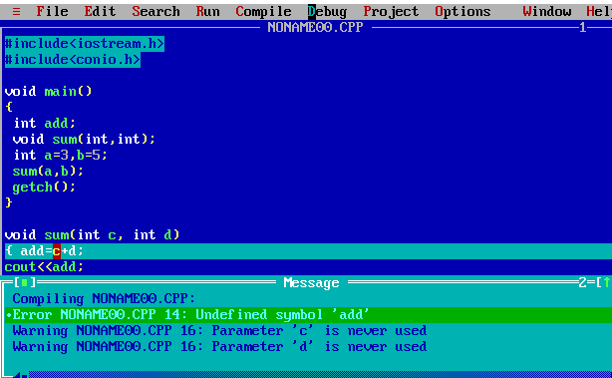

Slide 42
3. File scope : A name declared outside all blocks and function has file scope, i.e it can be used in all the blocks and functions written inside the file. (also known as global variables).
#include<iostream.h>
int a=20;
void main()
{void sum();
sum();
a=10;
cout<<a<<endl;
sum();
}
void sum()
{ a=a+30;
cout<<a<<endl;
}

Slide 43


Slide 44
3. File scope : A name declared outside all blocks and function has file scope, i.e it can be used in all the blocks and functions written inside the file. (also known as global variables).
#include<iostream.h>
int a;
void main()
{ a=10;
cout<<a<<endl;
void sum();
sum();
cout<<a;
}
void sum()
{ a=a+30;
cout<<a<<endl;
}

Slide 46
Global variable/ Prototype
If a function/variable is declared inside the main function then the function/variable can be used only by the main program. Whereas if you declare the function/variable globally then it can be used by all the functions in the program,

Slide 47
#include<iostream.h>
int a=10; //Global Variable
void main()
{ int b=15; //local variable
cout<<a<<“\t”<<b; }
output
10 15

Slide 48
1. void pos(int a[10],int m) ;
int position(int a[], int size, int num);
x-x² /3! + x³ / 5! -

Slide 49
#include<iostream.h>
int a=10;
void main()
{ int a=15;
cout<<a<<“\t”<<a; }
what will be the output ?????????
//Actually which variable is being called
global or local????

Slide 50
This will display the local variable. This is because the local and global variable has the same name. Thus the local variable a hides the global variable a.
To unhide global variable :: (scope resolution) operator has to be used.

Slide 51
#include<iostream.h>
int a=10;
void main()
{ int a=15;
cout<<::a<<“\t”<<a; }
output
????

Slide 52
LOCAL VARIABLE | GLOBAL VARIABLE
1. It is a variable that is declared with in a function or within a block | 1. It is variable which is declared outside all the functions
2. It is accessible only within a function/block in which it is declared | 2. It is accessible throughout the program

Slide 53
#include<iostream.h>
float val=10.0;
void value(int t)
{ int res=2;
return(res*t); }
void main()
{ cout<<val;
int b=value(2);
cout<<b;
}
local variable ??? Global variables ????

Slide 54
How to declare a constant?
void main()
{
int a=10;
cout<<a; // 10 will be displayed
a=a+10;
cout<<a;
}

Slide 55
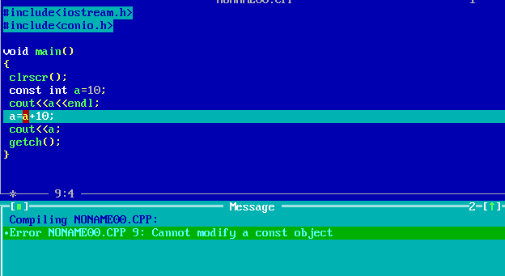

Slide 56
A function can be called invoked in 2 ways call by value & call by reference
During call by value, any change made to the formal parameter is not reflected back to the actual parameter.

Slide 57
void main()
{ void change( int );
int a=10;
change(a);
cout<<a;
}
void change( int c)
{ cout<<c<<endl;
c=25;
cout<<c<<endl;
}
a
10
c
10
c
25

Slide 58
During call by reference, changes made in the formal parameter are reflected back to the actual paramter.

Slide 59
void main()
{ void change( int & );
int a=10;
change(a);
cout<<a;
}
void change( int &c)
{ cout<<c<<endl;
c=25;
cout<<c<<endl;
}
a
10
c
a
25

Slide 60
void main()
{ void swap( int , int );
int a,b;
cin>>a>>b;
swap(a,b);
cout<<a<<b;
}
void swap( int c, int d);
{ int temp;
temp=c;
c=d;
d=temp;
cout<<c<<d;
}
Notes:
call by value for swapping numbers

Slide 61
void main()
{ void swap( int &, int &);
int a,b;
cin>>a>>b;
swap(a,b);
cout<<a<<b;
}
void swap( int &c, int &d);
{ int temp;
temp=c;
c=d;
d=temp;
cout<<c<<d;
}
Notes:
Call by reference for swapping numbers

Slide 62
ctype.h Functions
isdigit()
eg:
char ch; cin>>ch;
if(isdigit(ch)) // checks if ch is a digit
cout<<“Is a digit”;
else
cout<<“Not a digit”;

Slide 63
ctype.h Functions
isalpha()
eg:
char ch; cin>>ch;
if(isalpha(ch)) // checks if ch is an alpha
cout<<“Is an alphabet”;
else
cout<<“Not an alphabeth”;

Slide 64
ctype.h Functions
isupper()
eg:
char ch; cin>>ch;
if(isupper(ch)) /* checks if ch is upper case works only for alphabeth */
cout<<“Upper case”;
else
cout<<“Lower case”;

Slide 65
ctype.h Functions
islower()
eg:
char ch; cin>>ch;
if(islower(ch)) /* checks if ch is lower case
works only for alphabeth */
cout<<“Upper case”;
else
cout<<“Lower case”;

Slide 66
ctype.h Functions
toupper()
eg:
char ch; cin>>ch;
if(islower(ch))
{ ch=toupper (ch);
cout<<ch; or cout<<toupper(ch); }
else
cout<<“upper case”;

Slide 67
ctype.h Functions
tolower()
eg:
char ch; cin>>ch;
if(isupper(ch))
{ ch=tolower(ch);
cout<<ch; or cout<<tolower(ch); }
else
cout<<“lower”;

Slide 68
There are 3 types of functions
Computational function –that calculate and compute some value, they always returns a value.
Manipulative function- That return a success(1) or a failure(0) eg: isupper, islower
Procedural function- That performs an action and have no explicit return value eg: exit(0), getch()

Slide 69
DEFAULT ARGUMENTS

Slide 70
C++ allows default values to a function parameters which is useful in case a matching argument is not passed in the function call statement.
Eg void sum(int a,int b=5) //in definition
void interest(float p=9.5, int t=5,int r=9)

Slide 71
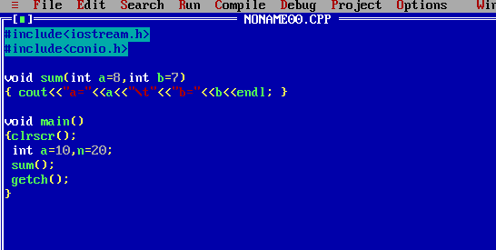

Slide 73
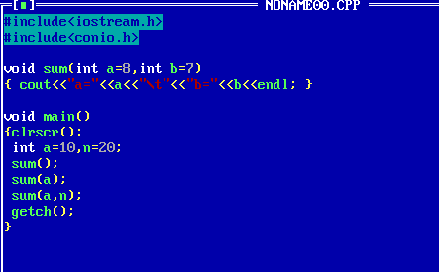

Slide 74


Slide 75
Predict the output
Void main()
{ cout<<interes(6100,1)<<endl;

Slide 76
PRACTICAL CLASS

Slide 77
IDENTIFIERS
Can be any variables, keywords, literals, punctuators, operators

Slide 78
Keywords
They are the words having special meanings or reserved words by programming language.
eg: if, while, int, short, void, char…..

Slide 79
Literals : are often referred to as constants that never change their value during execution.

Slide 80
How to declare a constant?
void main()
{ const int a=10;
cout<<a; // 10 will be displayed
a=a+10;
cout<<a;
}

Slide 82
Punctuators
eg ( ) // parameters in a function
; //end of a stmt
= // assignment
[ ] //array
{ } //compound stmt
: // for label goto
# // pre-processor directives

Slide 83
operators
Arithmetic
shift operator (<< , >>)
logical operator
Assignment operator (= ,+=,-=)
Relational operator
Conditional operator

Slide 84
UNARY, BINARY & TERENARY OPERATORS
Unary (operators that act on one operand are referred to as unary operators)
eg :++ , --, +,-
Binary (operators that act upon two operands are referred to as unary operators)
eg: a*b, a/8
Terenary
eg Conditional operator

Slide 85
What do you mean by cascading of I/O operators
The multiple use of input(>>) or output(<<) in one statement is known as cascading of I/O operators.
eg cin>>a>>b>>c;
cout<<“a=“<<a<<“b=“<<b<<“c=“<<c;

Slide 86
ctype.h
We can use inbuilt functions like
toupper() ,tolower(), isupper,islower
to change and see if a particular character is in upper case or not.

Slide 87
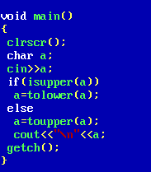

Slide 88
Program to exchange(swap 2 values using functions) such that
void main()
{ int a,b;
cin>>a>>b;
swap(a,b)
cout<<a<<b;
}
void swap()
{ …….
…..
cout<<a<<b;
}

Slide 89
Type Conversion – The process of converting one predefined type into another is called as type conversion
Implicit type conversion :
An implicit type conversion is a conversion performed by the compiler without programmer’s intervention.
ii. Explicit type conversion:
The implicit conversion of an operand to a specific type is called type conversion

Slide 90
eg int a,b;
float c;
c= (float)(a+b/3);

Slide 91
Predict the output
int Execute( int M)
{ if (M % 3 == 0)
return( M * 3);
else
return( M + 10); }

Slide 92
void output( int B = 2)
{ for (int T = 0; T < B; T++)
cout << Execute(T) << “*”;
cout << endl; }
void main()
{ output (4);
output ( );
output (3); }

Slide 93
void ChangeContent(int Arr[], int Count)
{ for(int C=1 ; C<Count ; C++)
{ Arr[C-1]+=Arr[C] ; }
}
void main()
{ int A[ ]={3, 4 , 5}, B[ ]={10,20,30,40}, C[ ]={900, 1200}, L ;
ChangeContent(A,3);
ChangeContent(B,4);
ChangeContent(C,2);

Slide 94
for(L=0 ; L<3 ; L++)
{ cout<<A[L]<<"#"; }
cout<<endl;
for(L=0 ; L<4 ; L++)
{ cout<<B[L]<<"#" ; }
cout<<endl;
for(L=0 ; L<2 ; L++)
{ cout<<C[L]<<"#" ; }
getch(); }

Slide 95
void changestring(char text[], int &counter)
{ char ptr[20];
strcpy(ptr,text);
int length=strlen(text);
for(;counter<length-2;counter+=2)
{ ptr[counter] = toupper(ptr[counter]); } }

Slide 96
void main()
{ clrscr();
int position = 0;
char message[]= “Mouse Fun”; changestring(Message,position); cout<<message<< “@” <<position; }

